Slide 1
DESIGN and ANALYSIS of ALGORITHMS HIMANSHU SRIVASTAVA CSE 2nd Year Roll no. : 181220031

Slide 2
SPANNING TREE
A spanning tree T of an undirected graph G = (V, E) is a sub-graph of G, with the minimum possible number of edges.
A graph may have several spanning trees.
A graph that is not connected does not have any spanning tree.

Slide 3
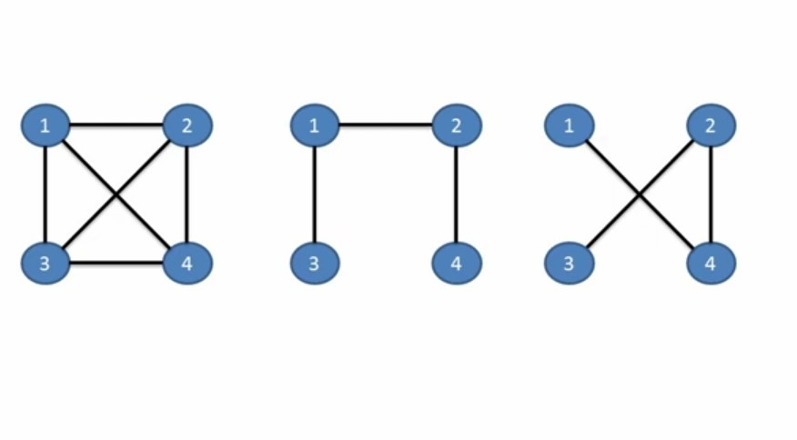
SPANNING TREE

Slide 4
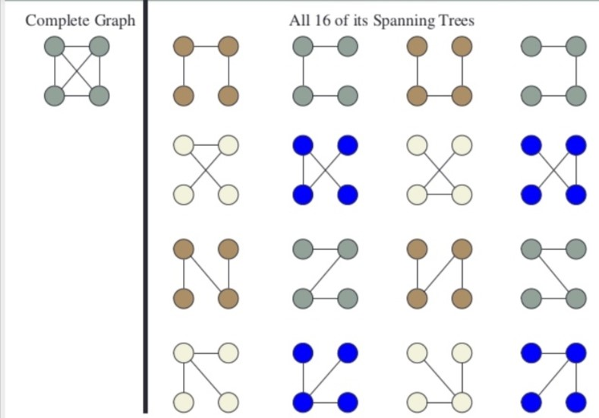
SPANNING TREE

Slide 5
MINIMUM SPANNING TREE ( MST )
A minimum spanning tree is a subset of the edges of a connected weighted undirected graph with the minimum possible total edge weights ( without any cycle ).
It is a spanning tree whose sum of weights is as small as possible.
A graph may have several minimum spanning trees.

Slide 6
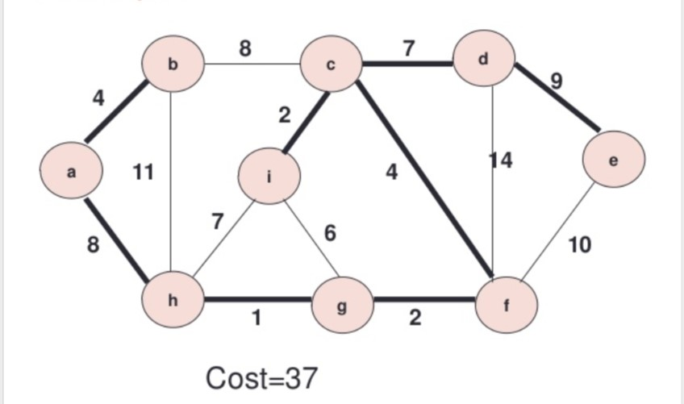
MINIMUM SPANNING TREE

Slide 7
MINIMUM SPANNING TREE
A minimum spanning tree has (V – 1) edges where V is the number of vertices in the given graph.
There are mainly two methods used to find minimum spanning out of a connected weighted graph :-
Prim’s algorithm
Kruskal’s algorithm

Slide 8
PRIM’s ALGORITHM
Prim’s algorithm is also a Greedy algorithm.
It starts with an empty spanning tree. The idea is to maintain two sets of vertices :-
The first set contains the vertices already included in the MST.
The second set contains the vertices not yet included.

Slide 9
PRIM’s ALGORITHM
At every step, it considers all the edges that connect the two sets.
Now, pick the minimum weighted edge from these edges.
After picking the edge, it moves the other endpoint of the edge to the set containing MST.

Slide 10
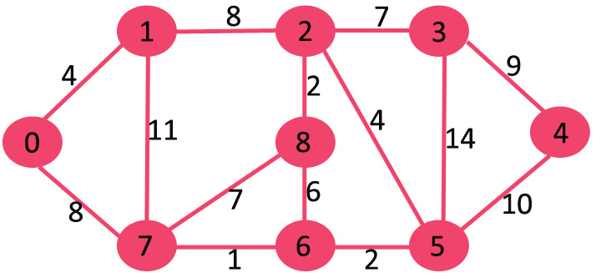
PRIM’s ALGORITHM
Find the MST for the following graph using prims algorithm.

Slide 11

PRIM’s ALGORITHM

Slide 12
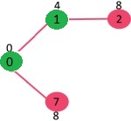
PRIM’s ALGORITHM

Slide 13
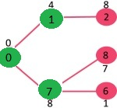
PRIM’s ALGORITHM

Slide 14
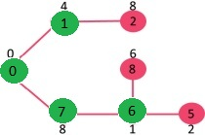
PRIM’s ALGORITHM

Slide 15
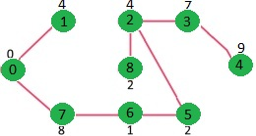
PRIM’s ALGORITHM

Slide 16
KRUSKAL’s ALGORITHM
Kruskal’s algorithm is also a Greedy algorithm.
The Greedy Choice is to pick the smallest weighted edge that does not cause a cycle in the MST constructed.
Let us go through steps for finding MST using Kruskal’s algorithm.

Slide 17
KRUSKAL’s ALGORITHM
Sort all the edges in non-decreasing order of their weight.
Pick the smallest edge. Check if it forms a cycle with the spanning tree formed so far. If cycle is not formed, include this edge. Else, discard it.
Repeat step#2 until there are (V-1) edges in the spanning tree ( MST ).

Slide 18
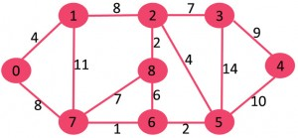
KRUSKAL’s ALGORITHM
Find the MST for the following graph using kruskal’s algorithm.

Slide 19

KRUSKAL’s ALGORITHM

Slide 20
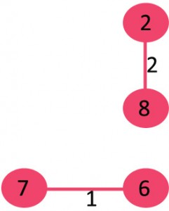
KRUSKAL’s ALGORITHM

Slide 21
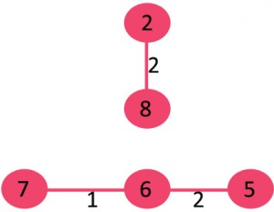
KRUSKAL’s ALGORITHM

Slide 22
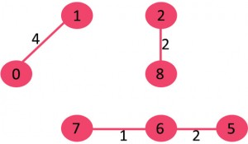
KRUSKAL’s ALGORITHM

Slide 23
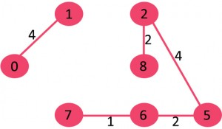
KRUSKAL’s ALGORITHM

Slide 24
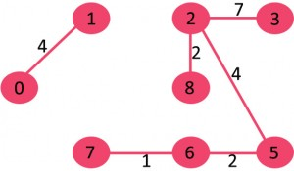
KRUSKAL’s ALGORITHM

Slide 25
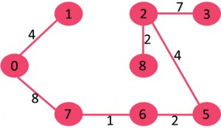
KRUSKAL’s ALGORITHM

Slide 26
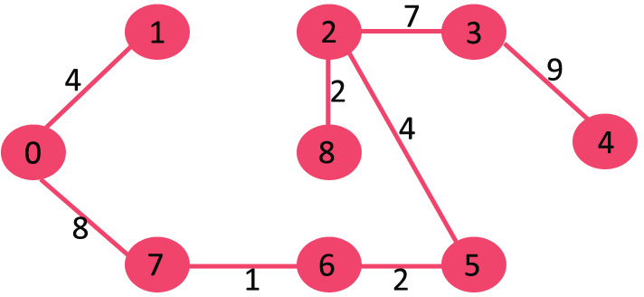
KRUSKAL’s ALGORITHM

